Slide 1
STAT 717: Class 11
Clustering
Vitaly Druker
November 11th, 2021

Slide 2
Introduction
Cluster analysis is used to create groups (or clusters) of observations.
It can also be used to cluster variables together
It is often discussed in the context of unsupervised learning
There are two main questions:
How to measure distances between observations (i.e. how do you know two things are ‘close’ together)
How to group them together (exhaustive combinations are not feasible)

Slide 3
Overview
Today
Measures of Similarity/Dissimilarity
Hierarchical Clustering (Agglomerative and Divisive)
Data Discussion
Next Week:
Non-Hierarchical Methods
Choosing the number of clusters/validity
Clustering variables (instead of observations)
Midterm review

Slide 4
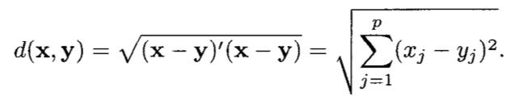

Measures of Similarity or Dissimilarity
Euclidean Distance
Adjust for different cov/var
The scale of values matters however. Typically you standardize each variable. What can be a possible issue with this (hint: we don’t know what the clusters are before standardizing)

Slide 5
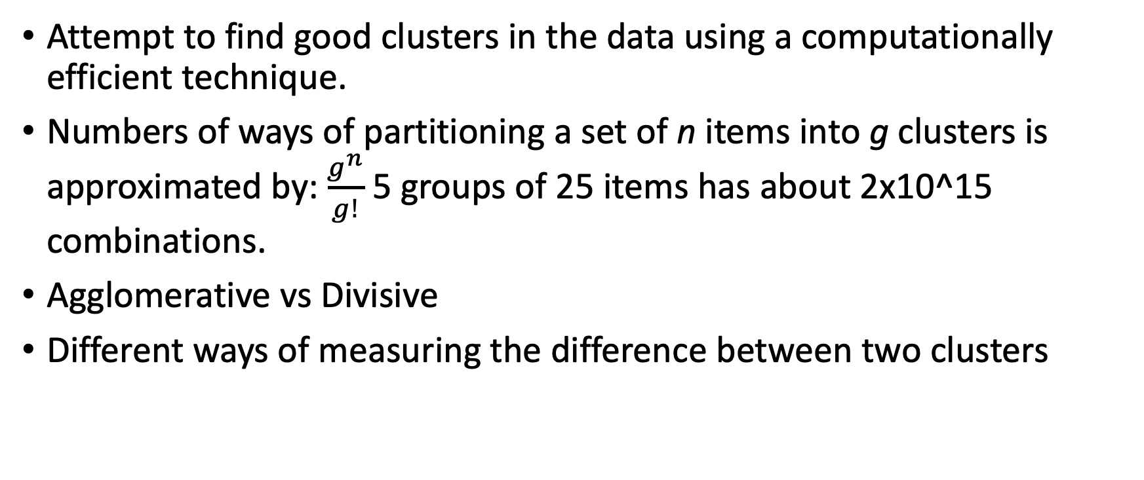
Hierarchical Clustering
Attempt to find good clusters in the data using a computationally efficient technique.
Numbers of ways of partitioning a set of n items into g clusters is approximated by: $\frac{g^{n}}{g!}$ 5 groups of 25 items has about 2x10^15 combinations.
Agglomerative vs Divisive
Different ways of measuring the difference between two clusters

Slide 6
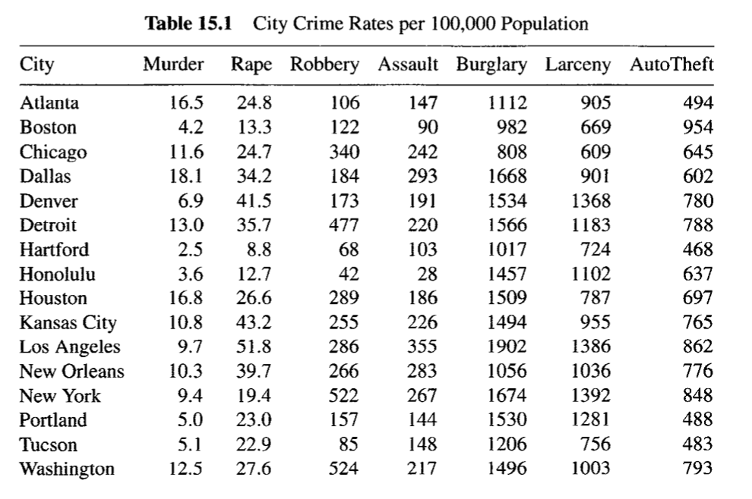
Example Data

Slide 7
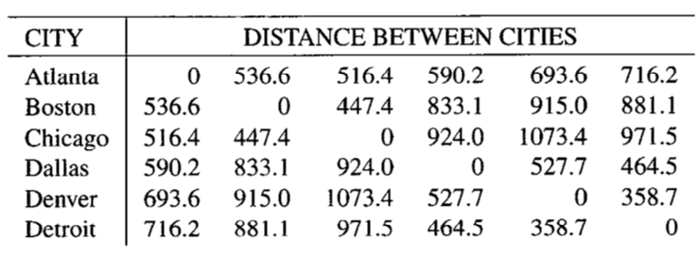
Distance Matrix
How would you create the first cluster?

Slide 8
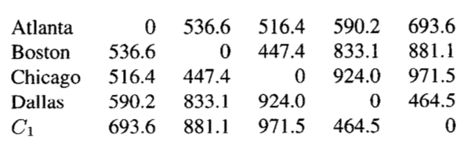
Combine first two:

Slide 9

Method 1: Single Linkage

Slide 10
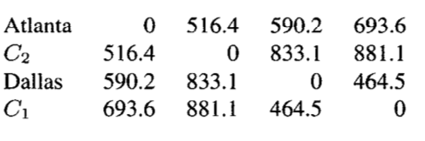
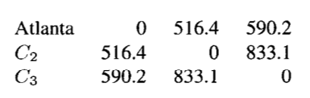

Method 1: Single Linkage

Slide 11
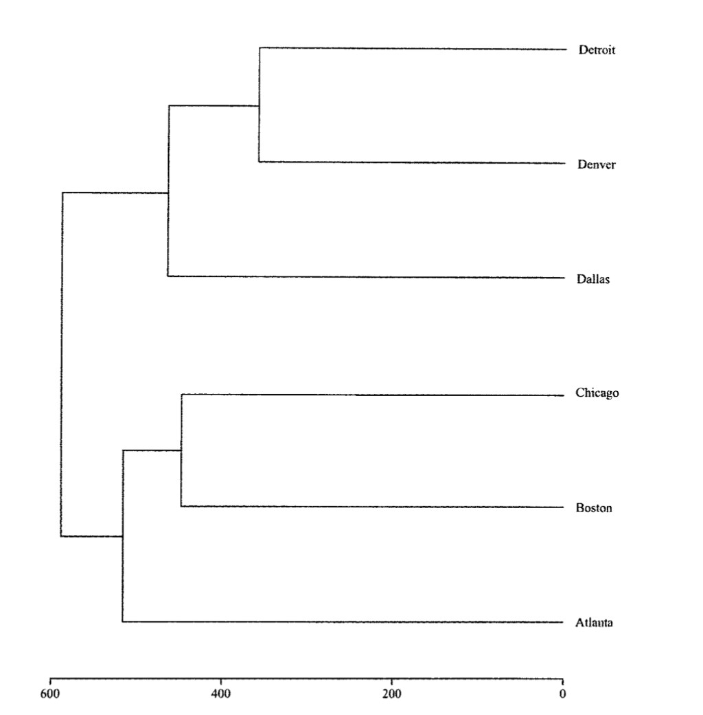
Method 1: Dendrogram

Slide 12

Method 2: Complete Linkage
First cluster is always the same (regardless of linkage method)
Here we take the largest distance between elements of the cluster.

Slide 13
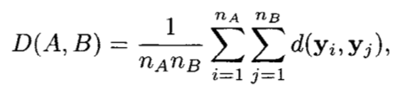
Average Linkage
Average the distance between all elements in a cluster:

Slide 14
Other methods:
Centroid Method
Euclidean distance between mean vectors of the two clusters.
Clusters that are joined have new values that are wegithed averages basted on elements in cluster
Median Method
Midpoint – of two clusters (unweighted) is used. Note it doesn’t have anything to do with a ‘median’.
Ward’s Method
Use sums with within-cluster distances as a metric to minimize (details on pg 518)

Slide 15
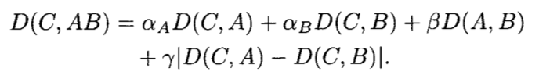
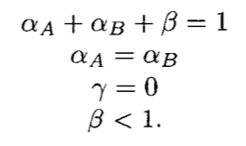
Flexible Beta Method
A general formula for the distance between AB and another cluster C:
Note that the formula only contains distances from before joining A and B.
The following parameter constraints are used:

Slide 16
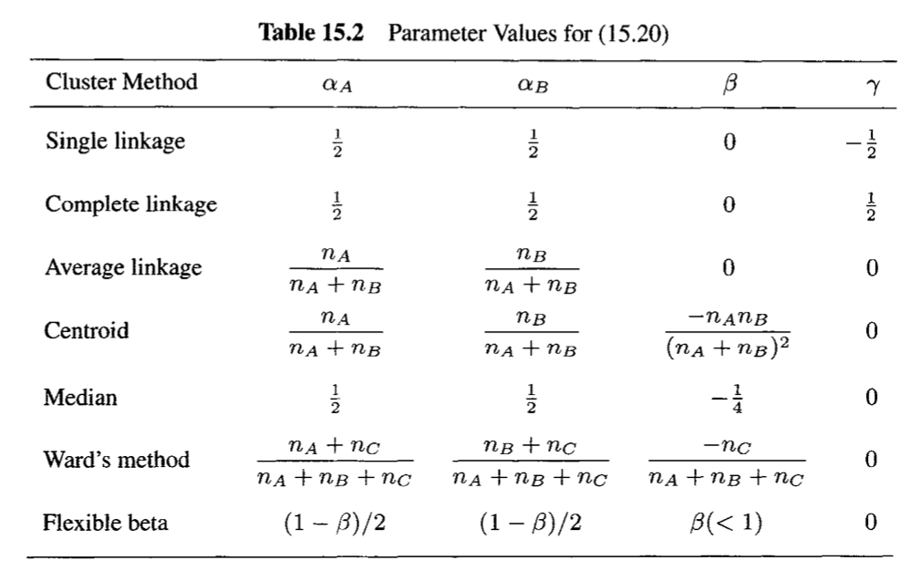
Flexible Beta Method – Table of values

Slide 17

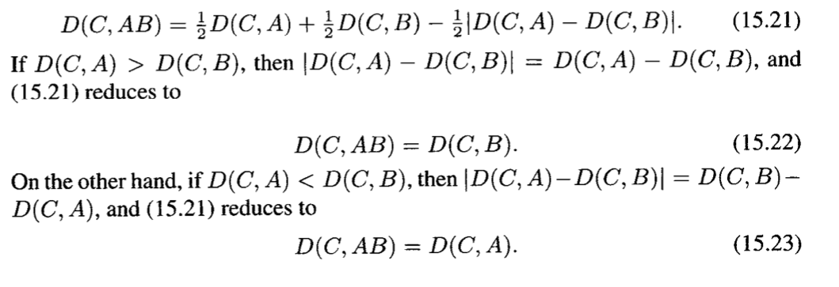

Flexible Beta – Single Linkage

Slide 18
Properties of Hierarchical Methods
Monotonicity
If an item or a cluster joins another cluster at a distance that is less than the distance for the previous merger – this is inversion or reversal
Single and complete linkage methods are monotonic
All the methods we discussed are monotonic besides centroid and median.
They showed crossovers in the dendrograms (ex pg 517)
Monotonic methods are generally preferred.

Slide 19
Properties of Hierarchical Methods
Contraction/Dilation
What happens to the distances between original points?
Space-conserving
Does not change space
Space Contracting
Newly Formed clusters appear to move closer to individual observations
Creates chaining tendancies – clusters absorb points
Space dilating
Newly formed clusters move away from individual observations
Points create clusters then join

Slide 20

Properties of Hierarchical Methods
Contraction/Dilation (cont)
Single linkage is very space contracting
Complete linkage is very space dilating
The flexible beta method is space contracting for $β=0$, space dilating for $β<0$ and space contracting for $β>0$

Slide 21
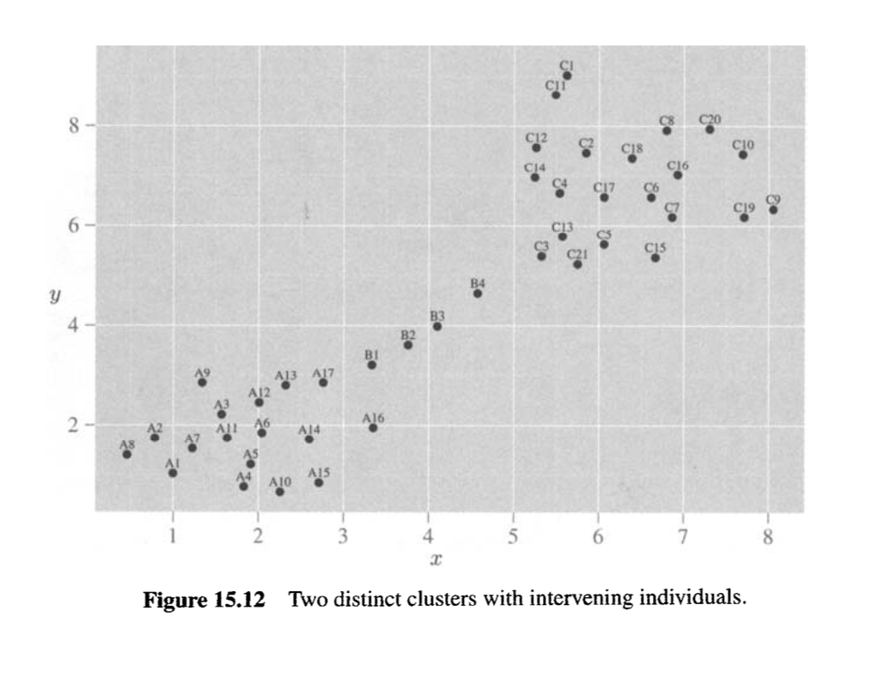
Example

Slide 22
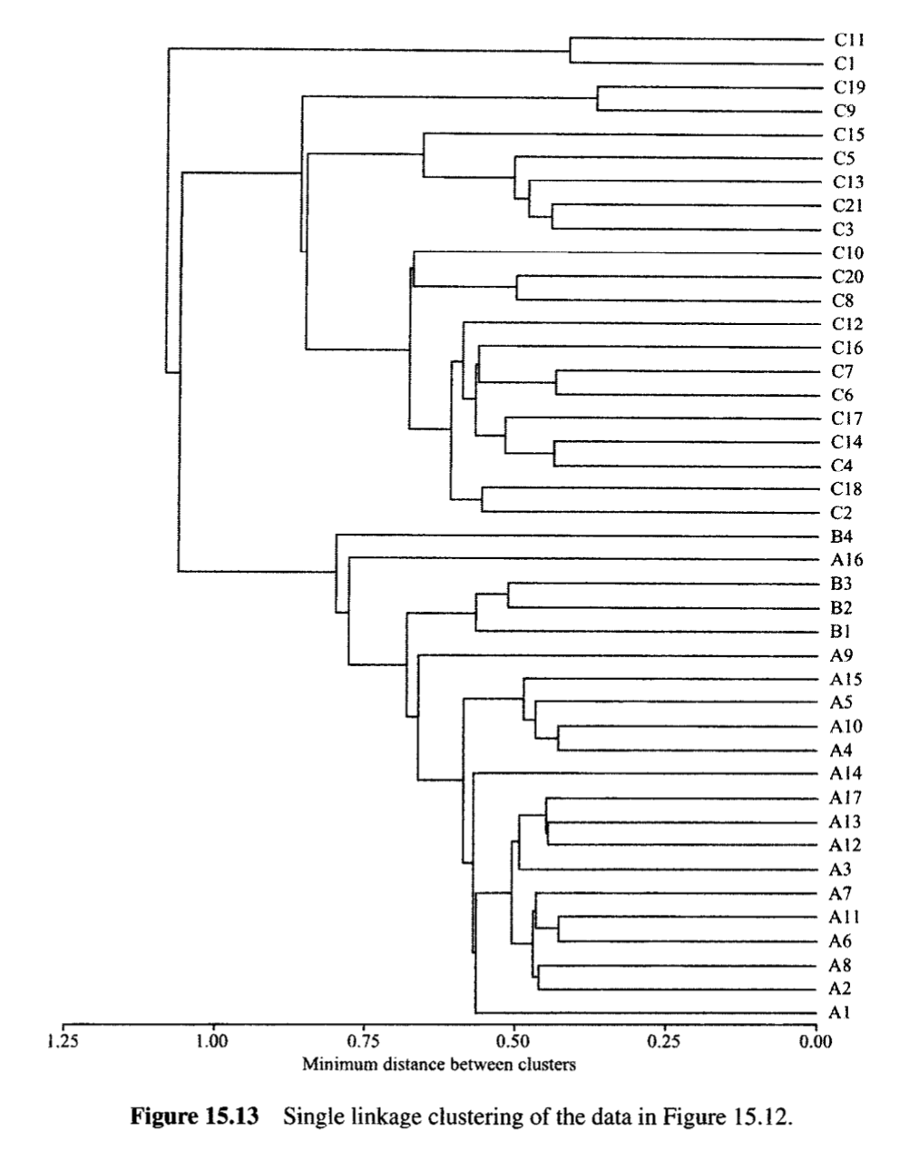
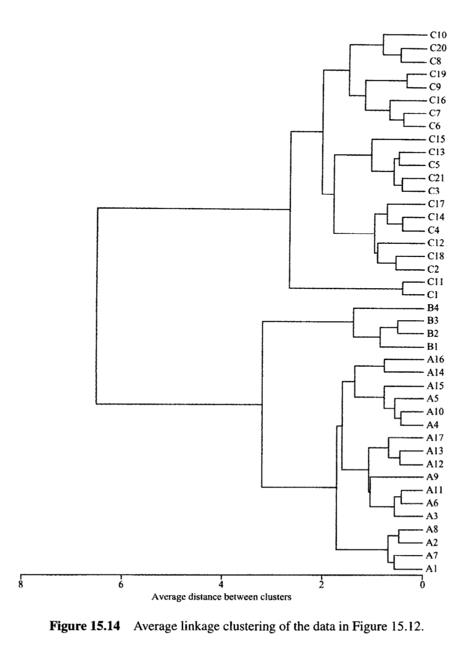







Slide 23
Other Properties
Single Linkage
Better identifies curvy shapes
Somewhat robust to outliers
Ward’s Method and average linkage
Insensitive to outliers
Centroid Method
Fairly robust to outliers
Complete linkage
Sensitive to outliers

Slide 24
Divisive Methods
Start with a single cluster and end up with n items.
Could be useful if you want large clusters (don’t need to join a bunch of groups)
Monothetic vs polythetic
How many variables are used to make a split

Slide 25

Divisive Methods
Monothetic (ex)
Seek to maximize the between-group sum of squares
Calculate for all variables and all splits of variables

Slide 26
R Examples

Slide 27
Nonhierarchical Method
Partitioning
Mixtures of distributions
Density estimation

Slide 28
Partitioning
Observations are separated into g clusters based on distance between all points

Slide 29
K-means
(The K is for the number of clusters but the book uses g)
Algorithm:
1. Choose g different places to start – this is generally done by picking g random observations. However, you can also choose ones that are furthest apart or something like that.
2. Assign points to the closest seed
3. Recalculate seed as centroid of all observations of that cluster
4. Repeat 2 and 3 until stabilized
It’s good to run this a few times with different starting seeds as there may be some local minima created. When creating the final grouping don’t forget to set the seed in your R script

Slide 30
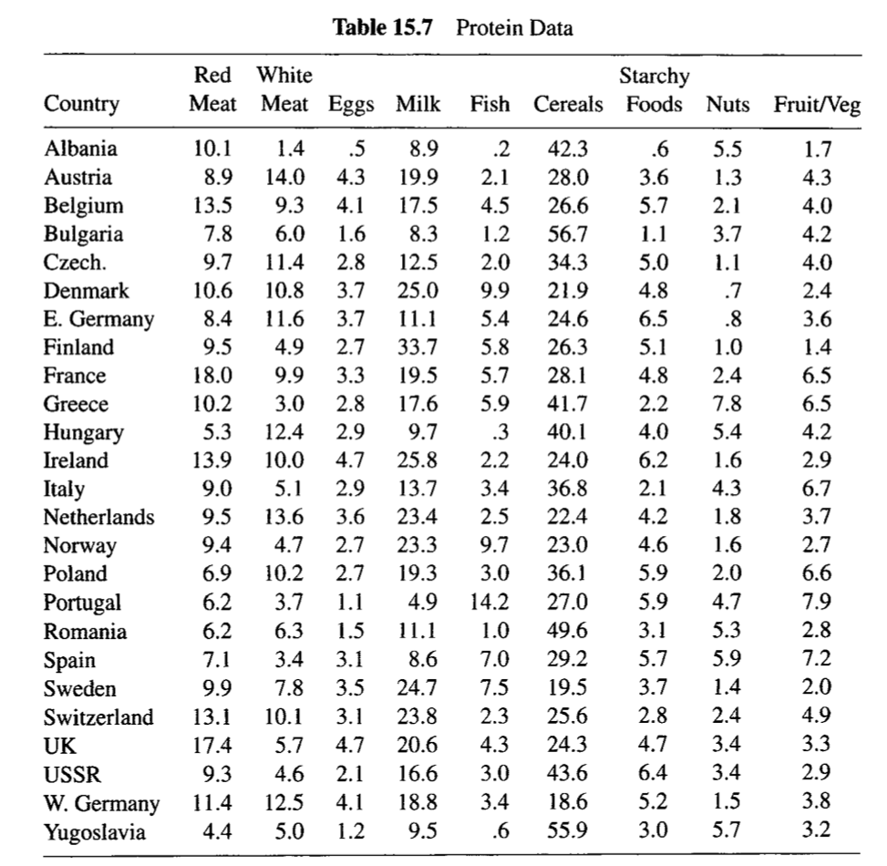
Example

Slide 31
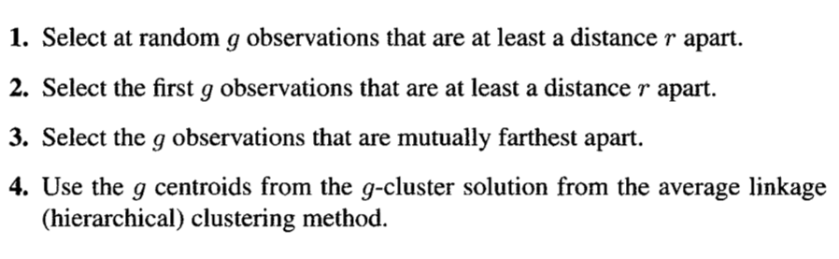
Example cont.

Slide 32
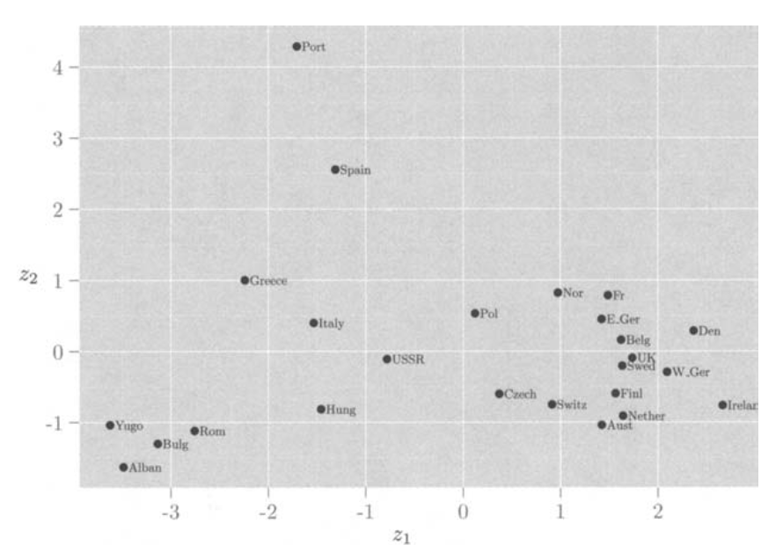
Aside: Choosing g
In my experience there is generally some constrains (e.g. you want the best 3 clusters) to cluster choosing
Otherwise run 5, 10, 15 etc. clusters and see which feels best
Book plots first two principle components and ‘identifies’ 5 clusters to try

Slide 33
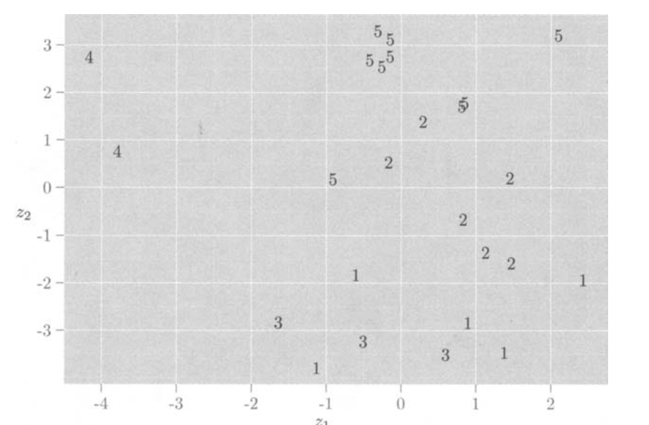
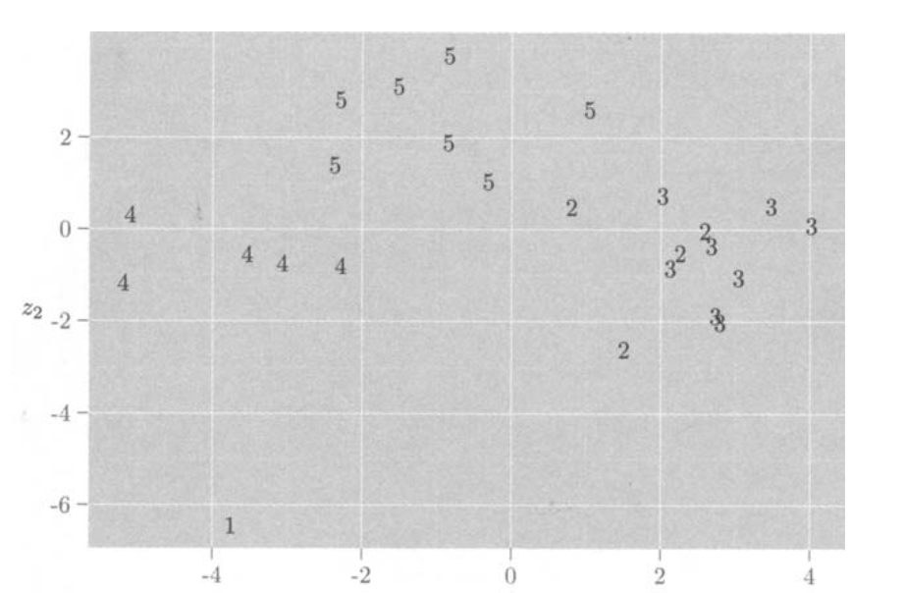
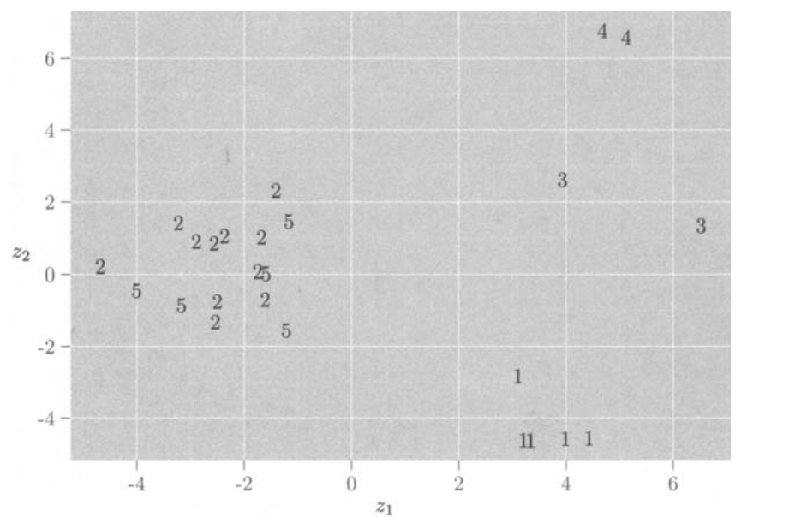
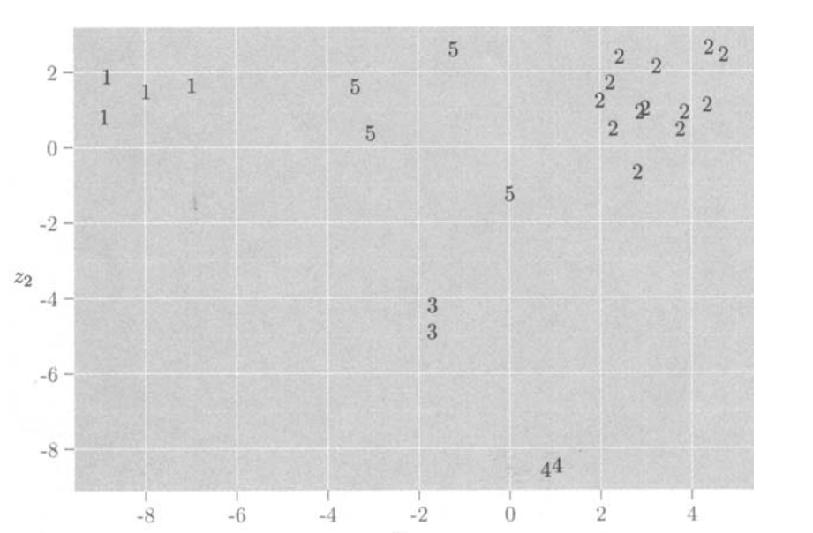
Plot Discriminant Functions to assess
First g at least r apart
Random at least r apart
Mutually furthest apart
G centroids from g-cluster solution

